Slide 1
Clustering and Segmentation of Bengaluru based on Restaurant data

Slide 2
Objective
To cluster the various localities of Bengaluru, India based on the restaurant data.
Cluster the localities with similar restaurant types and cuisines into clusters
Segment the localities to gather insights on the types of restaurants prevalent in a specific area and identify possible business avenues.

Slide 3
Data
Foursquare API data about the restaurants in Bengaluru.
Zomato API data containing the restaurant data of Bengaluru
https://www.kaggle.com/himanshupoddar/zomato-bangalore-restaurants
Built the data of geographical location of Bengaluru for map rendering
In total, data of 6160 restaurants across 84 localities in Bengaluru is used for the analysis
151 categories of restaurants is analyzed.

Slide 4


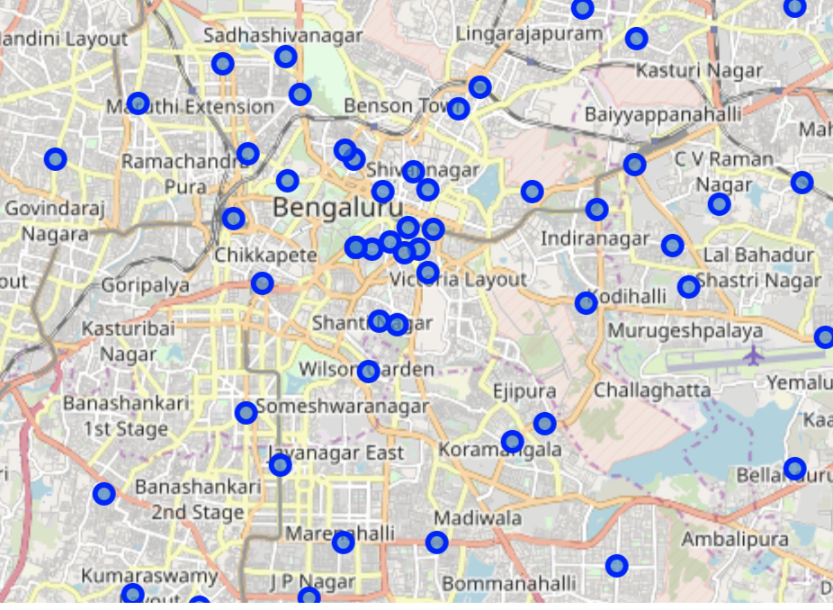
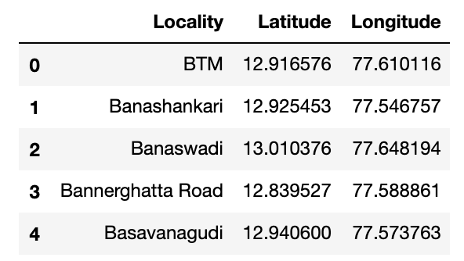

Bengaluru Localities under analysis

Slide 5
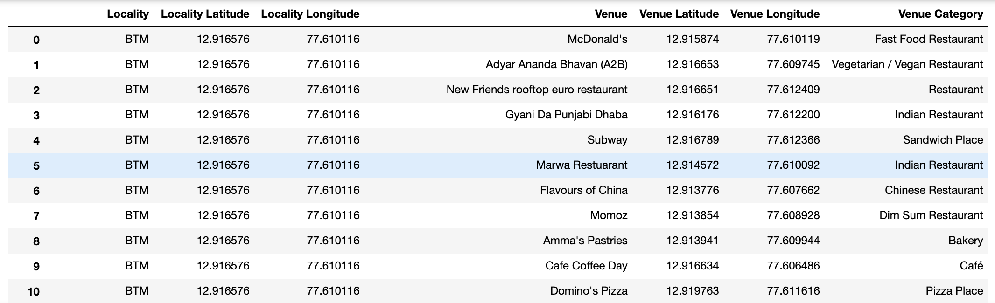
Restaurant data by Location

Slide 6
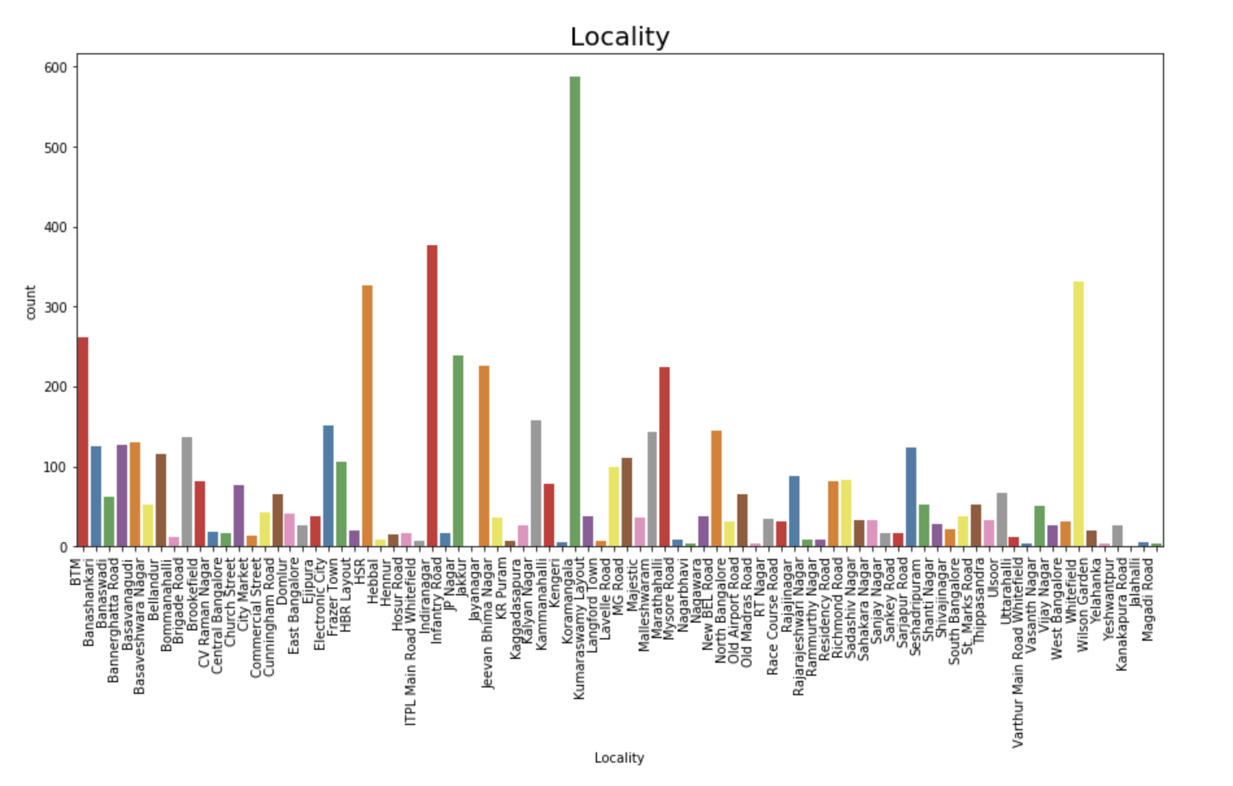
Data Visualization
Number of Venues by Locality

Slide 7
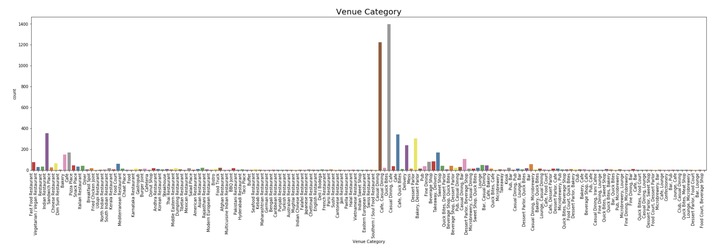
Data Visualization
Distribution of Venue Category

Slide 8
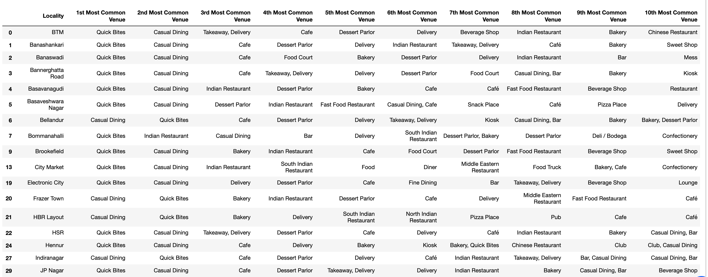
Methodology
The restaurants across 151 categories are analyzed to create top 10 common venue category per location

Slide 9
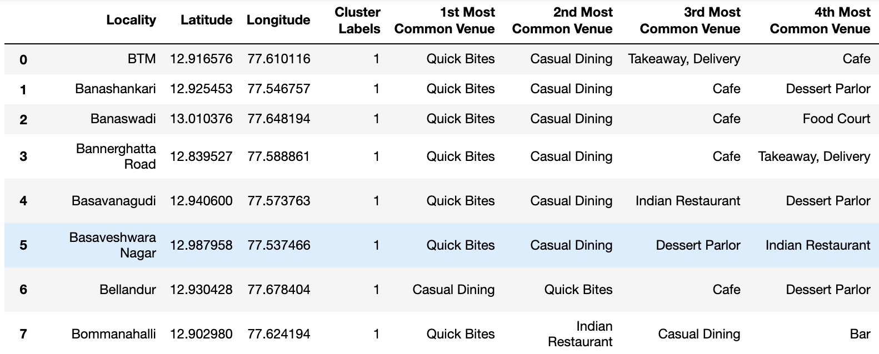
Methodology
K-Means clustering algorithm is used to cluster the similar localities.
K=5. 5 clusters are created to segment the localities.
Merged table with Cluster
label for each locality.

Slide 10
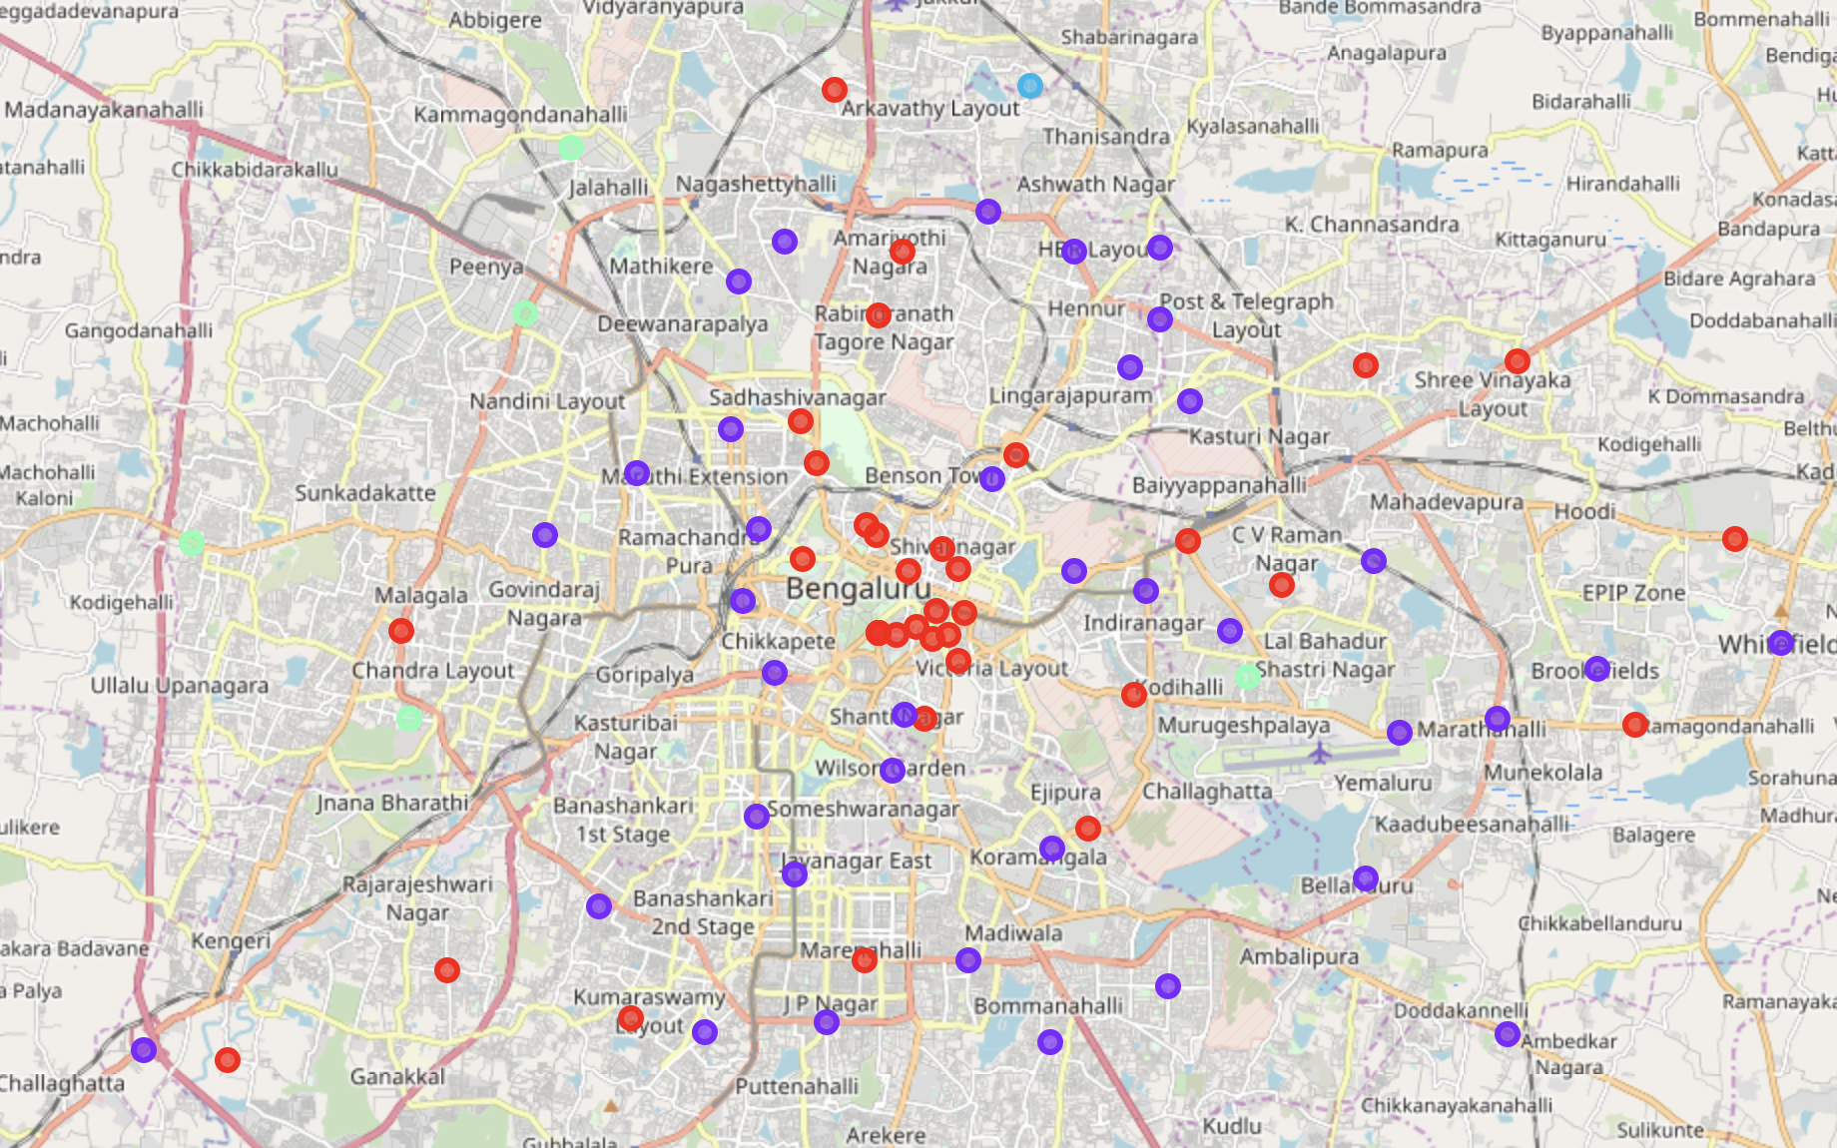
Observations
The clusters are identified using the K-Means algorithm.
The Cluster labels are decided based on the analyzing the cluster members and the top category in each cluster.

Slide 11
Observations
The cluster Labels are identified as :
Casual Dining
Quick Bites
Desserts Parlors
Café
Clubs

Slide 12
Results
The various localities are segmented into clusters based on the restaurant categories found in those localities
Provides insights on what restaurants are popular in which area.

